Slide 1
Toastmasters in Your Organization
Garrett Broughton
Notes:
Good <morning, afternoon, evening> everyone.
Thanks for taking the time to learn more about Toastmasters International.
Before I begin, let me introduce myself and my role in Toastmasters.
<Introduce self and background in Toastmasters.>
<ADVANCE TO NEXT SLIDE>

Slide 2
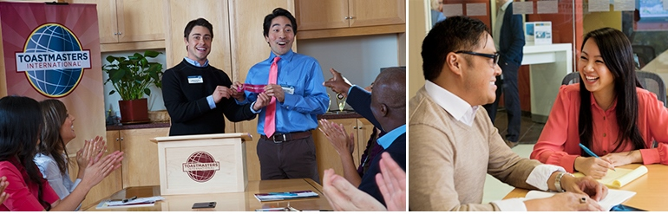
What is Toastmasters?
Toastmasters International is a world leader in communication and leadership development.
Notes:
Since 1924, Toastmasters International has helped millions of people become more confident in front of an audience. Our membership is 345,000 strong. Members improve their speaking and leadership skills by attending one of the 15,900 clubs in 142 countries that make up our global network of meeting locations.
<ADVANCE TO NEXT SLIDE>

Slide 3

How the Program Works
Members have the opportunity to practice:
Leading Meetings
Impromptu Speeches
Prepared Speeches
Constructive Evaluation
Notes:
Members attend regularly scheduled club meetings. The environment is friendly and supportive, and the self-paced program allows members to build confidence with each speaking assignment. Constructive evaluation is the heart of the Toastmasters program. Each time members give a prepared speech, an evaluator will point out strengths and suggest improvements.
<ADVANCE TO NEXT SLIDE>

Slide 4
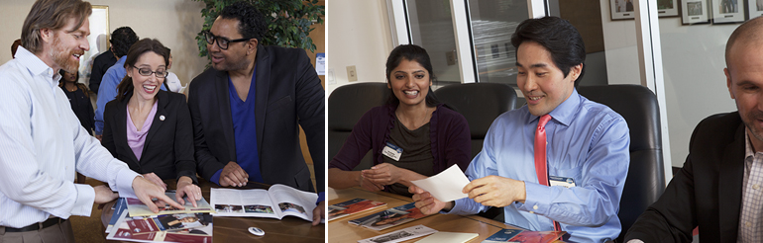
Education Program
Experiential Learning
Self-paced Program
Peer Feedback
Mentoring
Notes:
The education program is an important part of every Toastmaster's journey and is a critical aspect of every club meeting around the world. The Toastmasters Education Program is based on a proven curriculum that enables members to develop communication and leadership skills one step at a time. The program is built on four guiding principles that have been in place since Toastmasters was founded in 1924:
Experiential Learning–we learn by doing; by giving speeches and fulfilling leadership roles, we practice and improve
Self-paced Program–we learn best at our own pace and comfort level
Peer Feedback–through honest and supportive peer evaluation, we grow and improve
Mentoring–experienced members encourage, guide and support us in our goals and help us to achieve more than we thought possible
The program comprises two tracks: Communication and Leadership. The two tracks are not mutually exclusive; members may participate in both at the same time. Members progress through each track by completing a series of manuals that contain projects and evaluation guides. There are many opportunities for awards and recognition along the way.
<ADVANCE TO NEXT SLIDE>

Slide 5
Communication Track
Competent Communication
Advanced Communication Series
Notes:
Members interested in building their public speaking and communication skills begin with Competent Communication. The 10 speech projects in the Competent Communication manual help develop speaking skills one step at a time. When members finish all of the projects, they are eligible for the Competent Communicator award.
After receiving the Competent Communicator award, members can begin to develop more advanced speaking and communication skills through the Advanced Communication Series manuals. There are 15 in all, each containing five speech projects. Many of the manuals are career-oriented. Members choose the manuals they want to complete and the skills they want to learn.
Employees can practice these communication skills by:
Delivering technical briefings
Giving sales pitches
Connecting with the audience using targeted messaging
Focusing on gestures and body language
Using visual aids and props
<ADVANCE TO NEXT SLIDE>

Slide 6
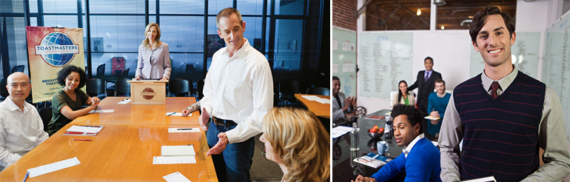
Leadership Track
Competent Leadership
Advanced Leader Program
Notes:
Members interested in building their leadership skills begin with Competent Leadership. This is the core of the Leadership track. The Competent Leadership manual features 10 projects that members complete while serving in various club meeting roles. An evaluator will provide feedback on each project. When a manual is completed, members are eligible for the Competent Leader award.
After earning the Competent Leadership award, members can further refine and develop more complex leadership skills by completing projects in manuals that are part of the Advanced Leader Program.
Employees can practice these leadership skills through practice in:
Developing a vision
Setting goals
Developing plans and strategies
Team building
<ADVANCE TO NEXT SLIDE>

Slide 7

Toastmasters Members Practice
Organizing and Leading Teams
Presenting Ideas Effectively
Conducting Productive Meetings
Providing Constructive Feedback
Notes:
Toastmasters’ hands-on training program also helps members to:
Enhance their management skills and organize teams by assembling and chairing committees.
Present ideas effectively by preparing and delivering impromptu speeches on assigned topics. They give better presentations by composing and delivering prepared speeches that meet specific objectives provided in program manuals.
Conduct productive meetings by practicing time-management, organization and planning skills as they lead Toastmasters club meetings.
Provide constructive feedback as they evaluate each other’s speeches and performance in leadership roles.
Members also learn to:
Listen better as they practice maintaining eye contact, observing body language and asking questions to confirm understanding during club meetings.
Develop their leadership potential by serving in club officer positions.
According to the 2013 SHRM® Workplace Forecast, 52% of HR professionals believe developing the next generation of corporate leaders will be the greatest challenge throughout the next 10 years. Toastmasters can help.
<ADVANCE TO NEXT SLIDE>

Slide 8










Toastmasters Corporate Club Sponsors
Notes:
Thousands of organizations see the value of Toastmasters International’s proven education program. These are just a few of the organizations that sponsor clubs.
Please note that the organizations listed on this slide can be updated to reflect well known organizations in your area.
<ADVANCE TO NEXT SLIDE>

Slide 9

Value of Toastmasters to Coca-Cola
“I see a great value in Toastmasters International’s proven programs for developing great communicators and influential leaders.”
Ceree Eberly
Senior Vice President & Chief People Officer
The Coca-Cola Company
Notes:
For nearly 42 years, the Coca-Cola Company has made the Toastmasters program available to its employees as part of its formal employee development plan. The international beverage giant, headquartered in Atlanta, Georgia, currently has four clubs: three in the United States and one in Sri Lanka. The Coca-Cola 310 North Toastmasters club was founded at The Coca-Cola Company’s headquarters in 1972 and currently boasts 59 members. The company launched its second Atlanta-based club, The Real Thing club, in 2002.
Coca-Cola’s Senior Vice President and Chief People Officer Ceree Eberly says in an interview published in the Toastmaster magazine:
“Toastmasters grooms associates today for tomorrow’s leadership challenges. It provides a safe and fun place where people learn to not only prepare and present speeches and presentations, but also to think on their feet in front of an audience. There is also the opportunity to share information and to get to know leaders and future leaders throughout the system. It is so exciting to see the growth in each associate who takes on this process. We believe in the program!”
The Coca-Cola Company experiences additional benefits from its Toastmasters clubs. Participating in Toastmasters:
• Increases associates’ ability to express ideas and turn corporate plans into action
• Elevates associates’ ability to make presentation to managers and customers
• Enables employees to share ideas with co-workers globally in more effective ways
• Improves English-speaking skills for associates who speak English as a second language
• Trains associates to give presentations and step into leadership roles
• Builds stronger interpersonal relationship and boost confidence
• Enhances company culture through internal and external communications.
<ADVANCE TO NEXT SLIDE>

Slide 10
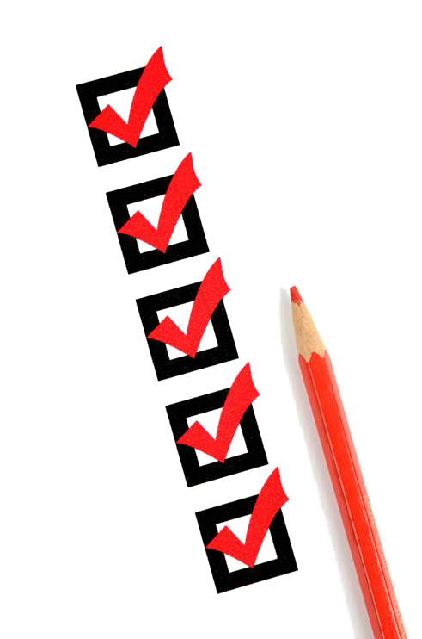
Value of Toastmasters
Enhanced Performance
Heightened Morale
Better Customer Service
Ideas Presented Effectively
Increased Productivity
Improved Teamwork
Notes:
What’s in it for your organization?
Enhanced performance. The ongoing experience of participating in interactive club meetings allows your employees to gain confidence and reinforces the communication and leadership skills they learn.
Heightened morale. Employees build confidence by learning communication and leadership skills.
Better customer service. Employees who participate in Toastmasters meetings develop keen listening and quick-thinking skills to provide clear, accurate information and answers to customers’ questions about your products or services.
By leading Toastmasters meetings, your employees learn to conduct efficient workplace meetings to present ideas effectively and share expertise, producing valuable results.
Increased productivity. An organized and prepared employee is a productive employee. Your employees develop time-management skills by delivering prepared speeches and impromptu responses to assigned topics within a prescribed time.
Improved teamwork. Better communication within your team results in a collective attitude of unity and cooperation that enables employees to quickly solve problems and implement decision-making.
<ADVANCE TO NEXT SLIDE>

Slide 11
Value of Toastmasters to your Organization
Enhanced Performance
Heightened Morale
Better Customer Service
Ideas Presented Effectively
Increased Productivity
Improved Teamwork
Notes:
Showcase how Toastmasters is valuable to a successful company in your local area. Explain the issues/challenges the company had and the positive results it gained by sponsoring a Toastmasters club.
Skip this slide if you do not have an example available.
<ADVANCE TO NEXT SLIDE>

Slide 12
Club Charter Details
$125: One-time charter fee
$20: New-member fee
$45: Six months’ membership dues
Maximum investment from your Organization
Notes:
As you can see, the initial investment to start a Toastmasters club here at your organization is minimal.
$125: One-time charter fee
$20: New-member fee per person
$45: Six months' membership dues per person ($33.75 for clubs not in a district)
Each club can charge supplementary dues to help cover expenses, if needed.
Here are a few of the most common levels of support offered by sponsoring organizations:
Meeting accommodations
Payment of the one-time charter fee
Reimbursement or payment of full or partial membership dues and new-member fees
Permission to hold meetings during company time
Incentives for achieving goals
Formal integration of Toastmasters meetings in the organization’s training program
<ADVANCE TO NEXT SLIDE>

Slide 13
Charter Kit Details
Distinguished Club Program and Club Success Plan
Distinguished Club Program Goals
Membership Building Kit
New Member Orientation Kit for Clubs
Club Leadership Handbook (7)
Master Your Meetings
Thank Fast! Table Topics™ Handbook
Ballots & Brief Evaluations (250)
CC Achievement Chart
CL Achievement Chart
Gavel
Membership Cards (50)
Timing Cards
Charter Kit Flier
Notes:
Each new member will also receive their personal Competent Communication and Competent Leadership manuals to guide them through their Toastmasters journey.
<ADVANCE TO NEXT SLIDE>

Slide 14
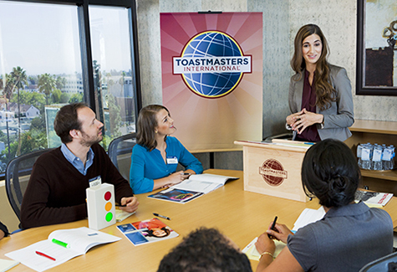
Next Step—Demonstration
Notes:
Tell the main contact how company employees also receive a lot of benefits, if not more, and let them experience the benefits first‐hand by scheduling a demonstration meeting.
<ADVANCE TO NEXT SLIDE>

Slide 15
Q&A
Notes:
Thank you for your time today. Are there any questions?

